Slide 1
Functions

Slide 2
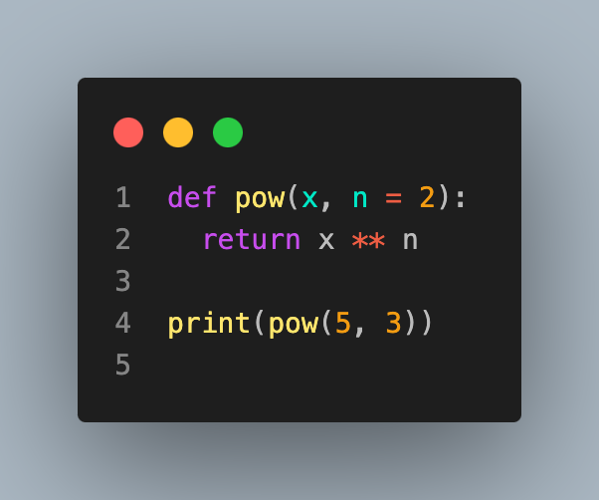
Defining a function
Python allows for the creation of functions, which help us abstract our data manipulations and create reusable code
Creating functions in python is easy, let's go through an example of creating a function that raises a number to an integer power (which isn't necessary since there's already an operator to do this)
125

Slide 3
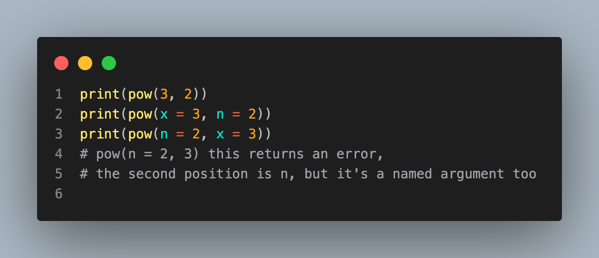
Function arguments
Our function has a mandatory argument, x, and an optional argument, n
The optional argument takes the default value 2
Consider the following about function argument ordering
9
9
9

Slide 4
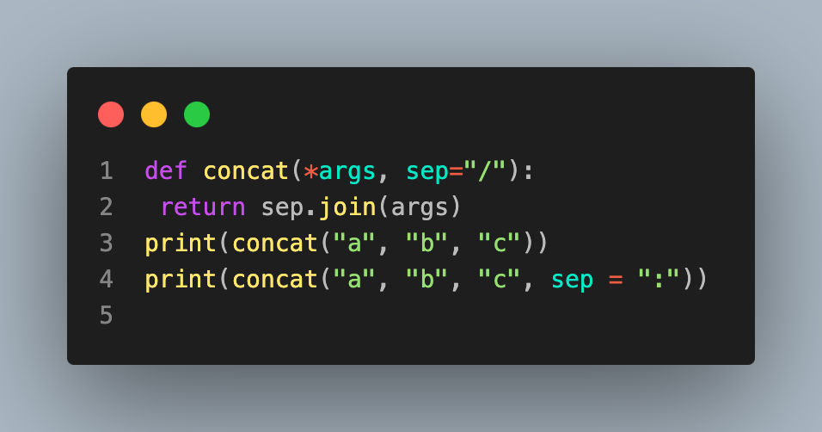
Variable length arguments
You can create functions with variable length arguments
Here's an example where we make an (unnecessary) string concatenation function
a/b/c
a:b:c

Slide 5
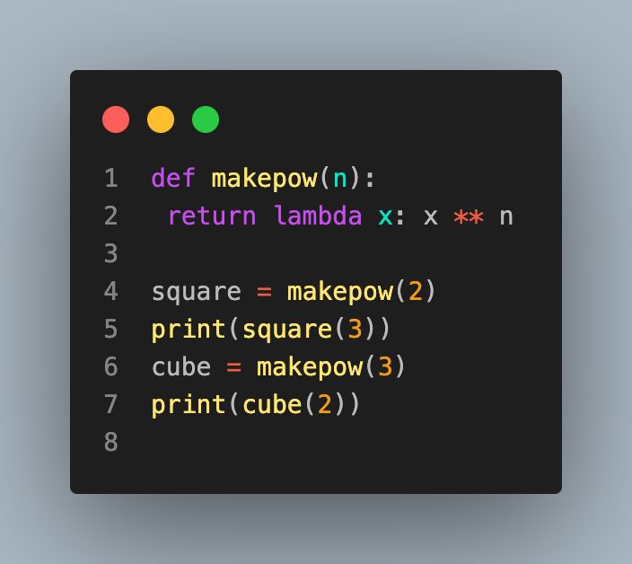
Lambda
The lambda function can be used to make quick function declarations
A good example is when you need a function as an argument to a function
Here's an example where we make a function that returns a function
9
8

